Slide 1

Errors as a driver of nonlinear mortality risk artefacts
The serious problem behind an Ig Nobel prize
Dr Saul Newman
University College London Oxford Institute of Population Aging
University College Oxford

Slide 2
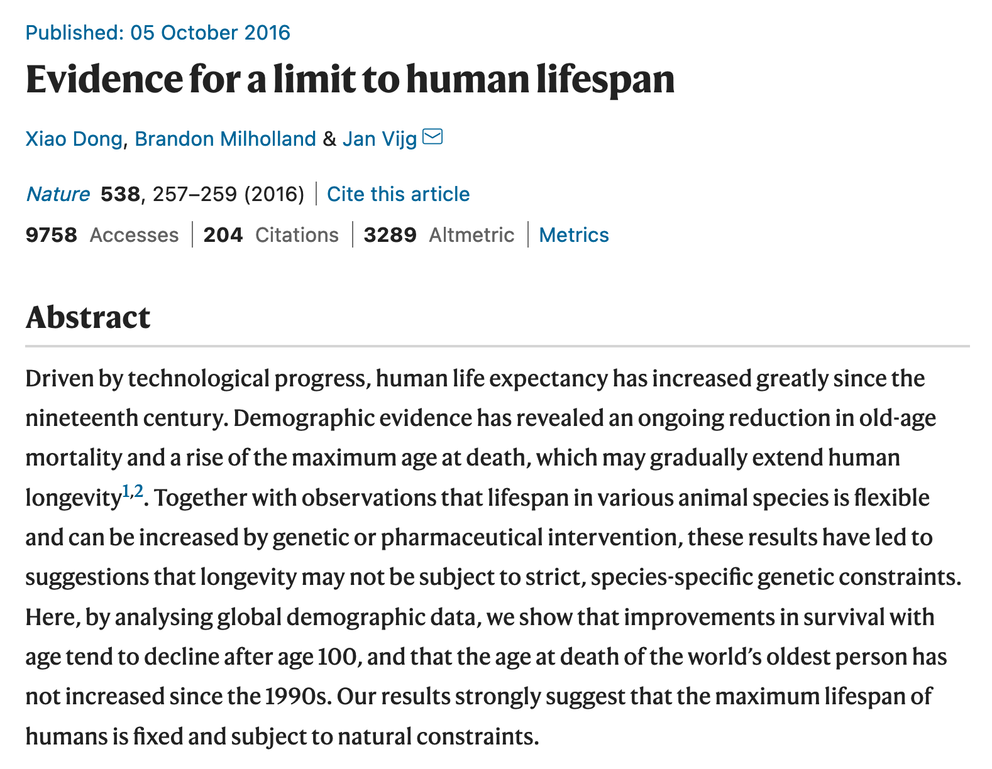
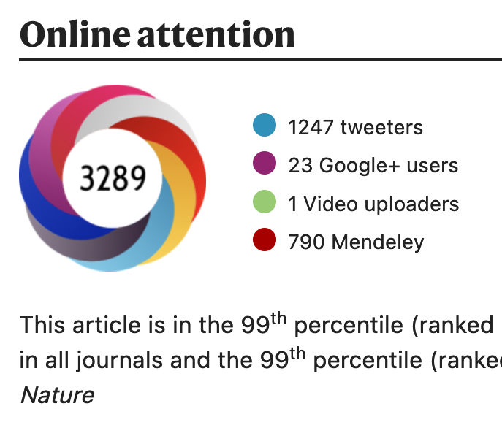
In 2016 someone sent me this paper…

Slide 3
They used Zero-Rounded Values to Measure Mortality Rates
Age, years | USA 2007 Males
 | q_{x} | l_{x} | e_{x}
0 | 0.007379 | 100,000 | 75.38
1 | 0.000494 | 99,262 | 74.94
… | … | … | …
111 | 0.618533 | 1 | 1.07
112 | 0.649460 | 0 | 1.00
113 | 0.681933 | 0 | 0.94
114 | 0.716029 | 0 | 0.87
115 | 0.751831 | 0 | 0.81
Age, years | USA 2017 Males |  | Dong et al | Reality
 | q_{x} | l_{x} | l_{x} 2017 - l_{x} 2007 | 2017 q_{x} - 2007 q_{x}
0 | 0.006304 | 100000
1 | 0.000426 | 99370
… | … | …
111 | 0.605799 | 1 | 0 | -0.012734
112 | 0.636089 | 0 | 0 | -0.013371
113 | 0.667893 | 0 | 0 | -0.01404
114 | 0.701288 | 0 | 0 | -0.014741
115 | 0.736353 | 0 | 0 | -0.015478
Data is
Not Zero
Dong et al data-
Rounded to Zero
Dong et al use zero rates of change… Not the data

Slide 4
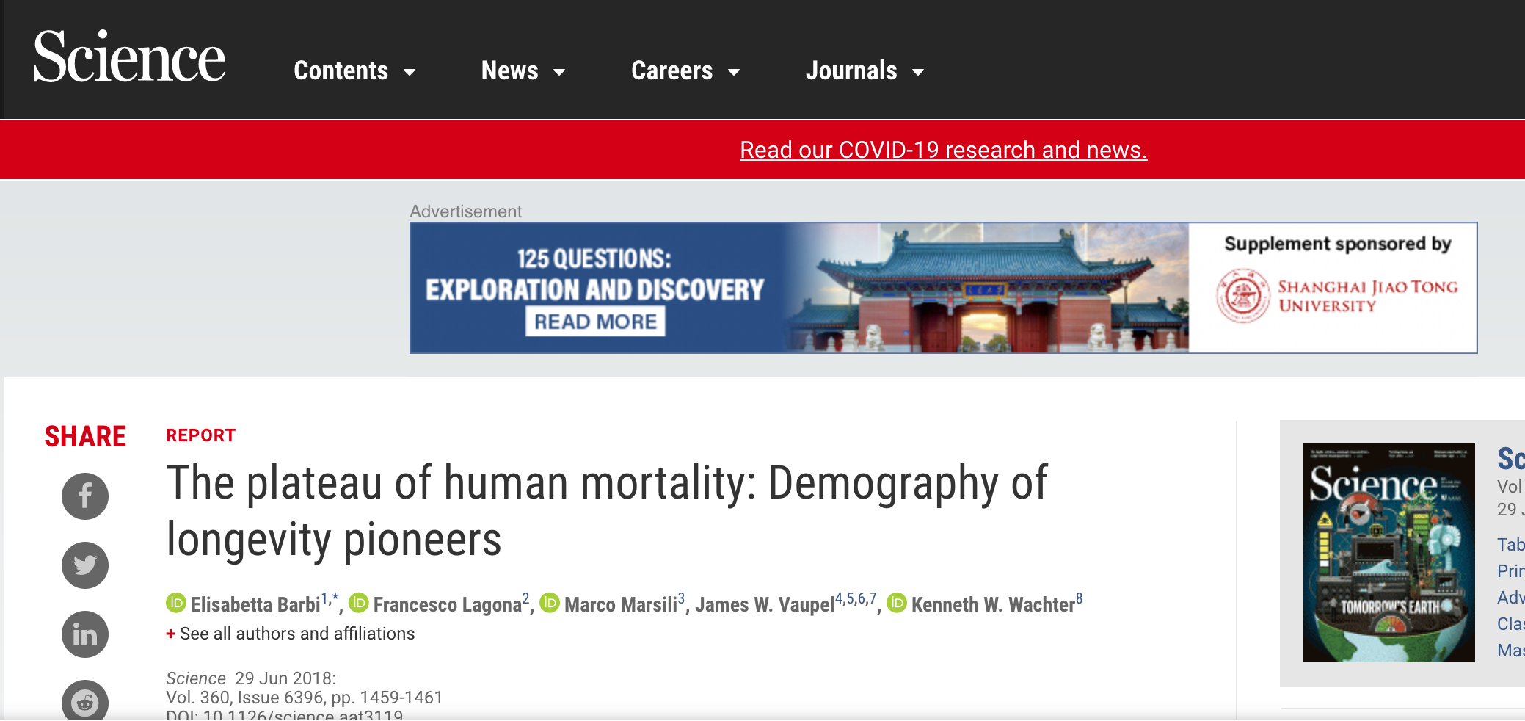
But wait!

Slide 5
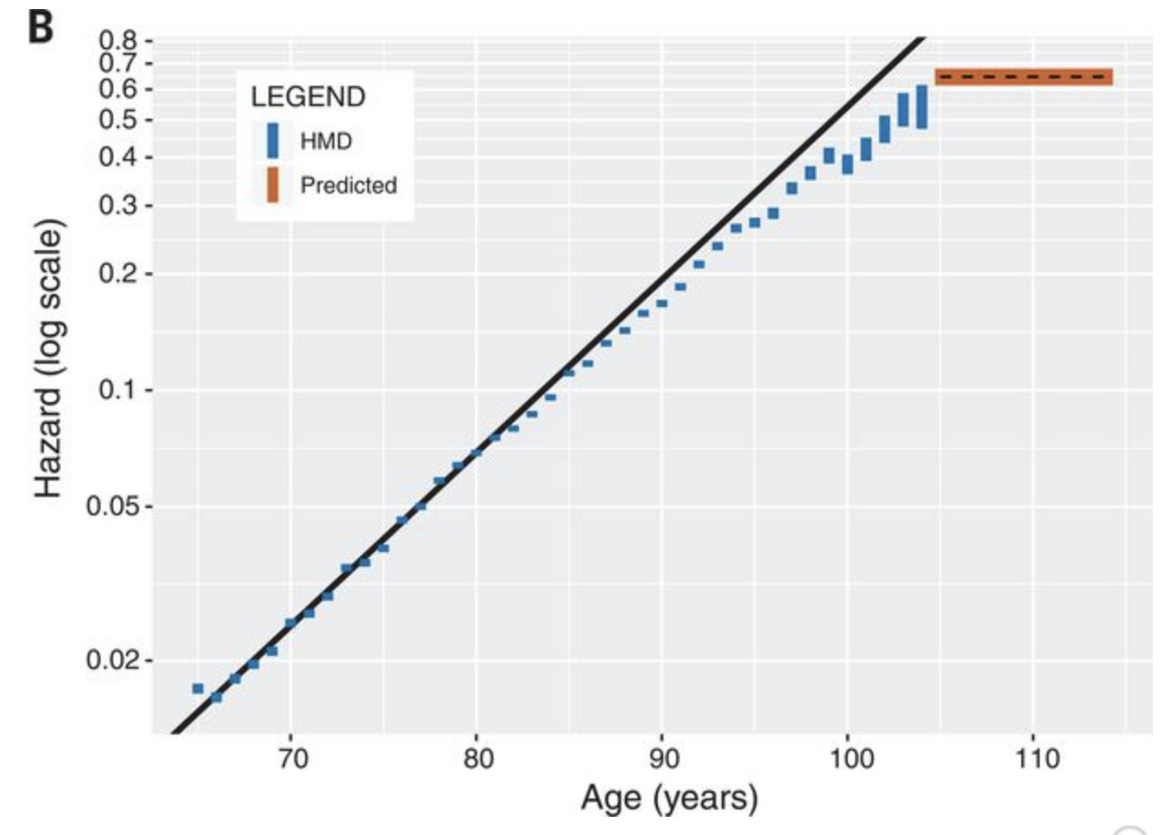
They had fit the same general model and reached the opposite conclusion.
Oh Golly!
Black regression, fit to ages 65-80
The “best estimate” model, according to Barbi et al.
Redrawn from Barbi et al. Fig. 1b

Slide 6
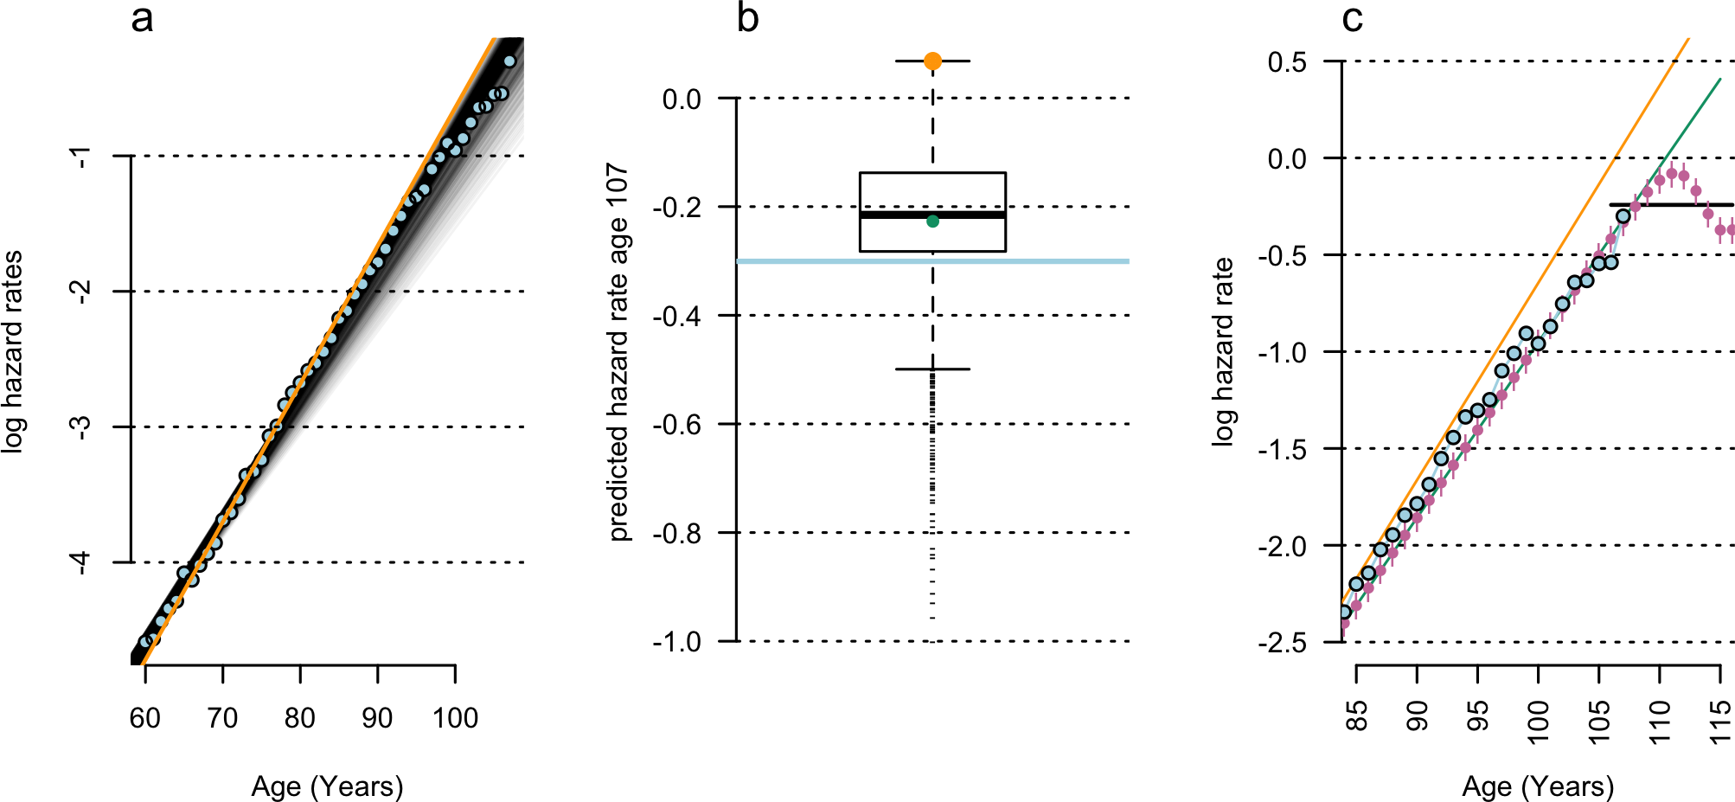
Barbi et al. (orange) makes the biggest plateau. Has the worst fit possible.
Green line is “most ordinary” regression
(median MSE)
Absolutely no plateau.
SJ Newman (2018) PLOS Biology. Plane inclinations: A critique of hypothesis and model choice in Barbi et al

Slide 7
But the problem. What was it?
Newman and Easteal (2016) The dynamic upper limit of human lifespan
https://f1000research.com/articles/6-569

Slide 8





The limits of survival (in humans)
‘Limit-possible’ solution: Model that can be projected to q=1
Implies capacity for limit to survival:
an age at which the
probability of mortality = 1.
MSA
(upper limit of life)
q = 1
?
About q = 0.5
q limit
(upper limit of mortality risk)
‘Flattening’ solution:
Limit of mx / qx – upper limit
to rate or force of mortality.
Does not imply limit to survival -
Just an upper cap on
the rate of mortality.
Longevity is probabilistic but finite
(no limit)
Log probability of death q
Depends on accurate
data in old age
Age

Slide 9





Knowing ages is fundamental to
Demography & Medicine
Real person. Real documents
Must be a real connection?
We only assume this bit

Slide 10
Knowing ages is fundamental to
Demography & Medicine
Real person. Real documents
What if I just steal real documents?
Or what if the real documents record the wrong thing?

Slide 11
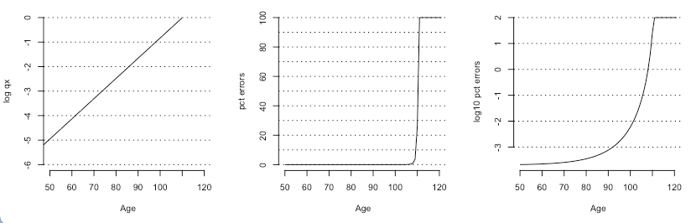



Take any null model…
Add (say) 1 in 100k age-coding errors at (say) age 50.
Errors accumulate nonlinearly with age…
Causing exploding error rates

Slide 12
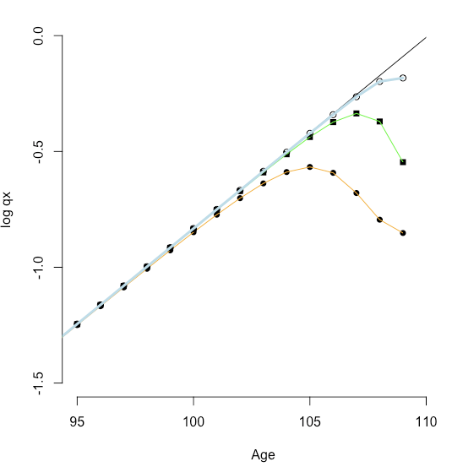
1 in 100k errors
Start diverging slowly,
then huge divergence
near oldest age / MSA
1 in 10k errors
1 in 1k errors
Completely artefactual flattening
(Errors in modern, double-entry US clinical trial
records are ~1 in 500)
Error free null

Slide 13
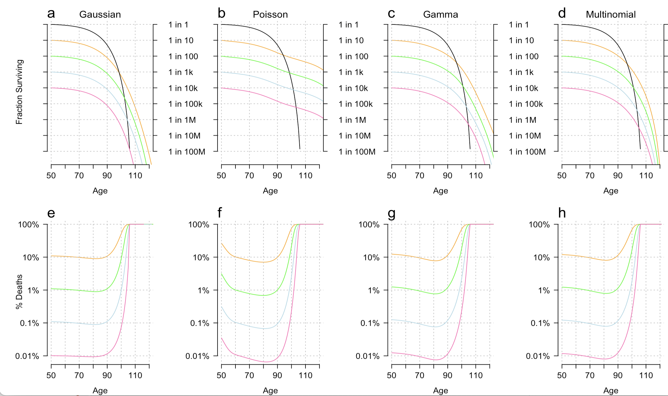
Age limit 105
Null model log-linear
10% error
1% error
0.1% error
0.01% error
Theoretical paper
Null model
Is black line
Writing this up – don’t share please

Slide 14
Fraction of errors
Age limit 105
Null model log-linear
10% error
1% error
0.1% error
0.01% error
There is a massive explosion in error rates.
This breaks assumptions in all current models of mortality
Theoretical paper
Null model
Is black line
Writing this up – don’t share please

Slide 15
Does the math solve problems?
Newman and Easteal (2016) The dynamic upper limit of human lifespan
https://f1000research.com/articles/6-569

Slide 16
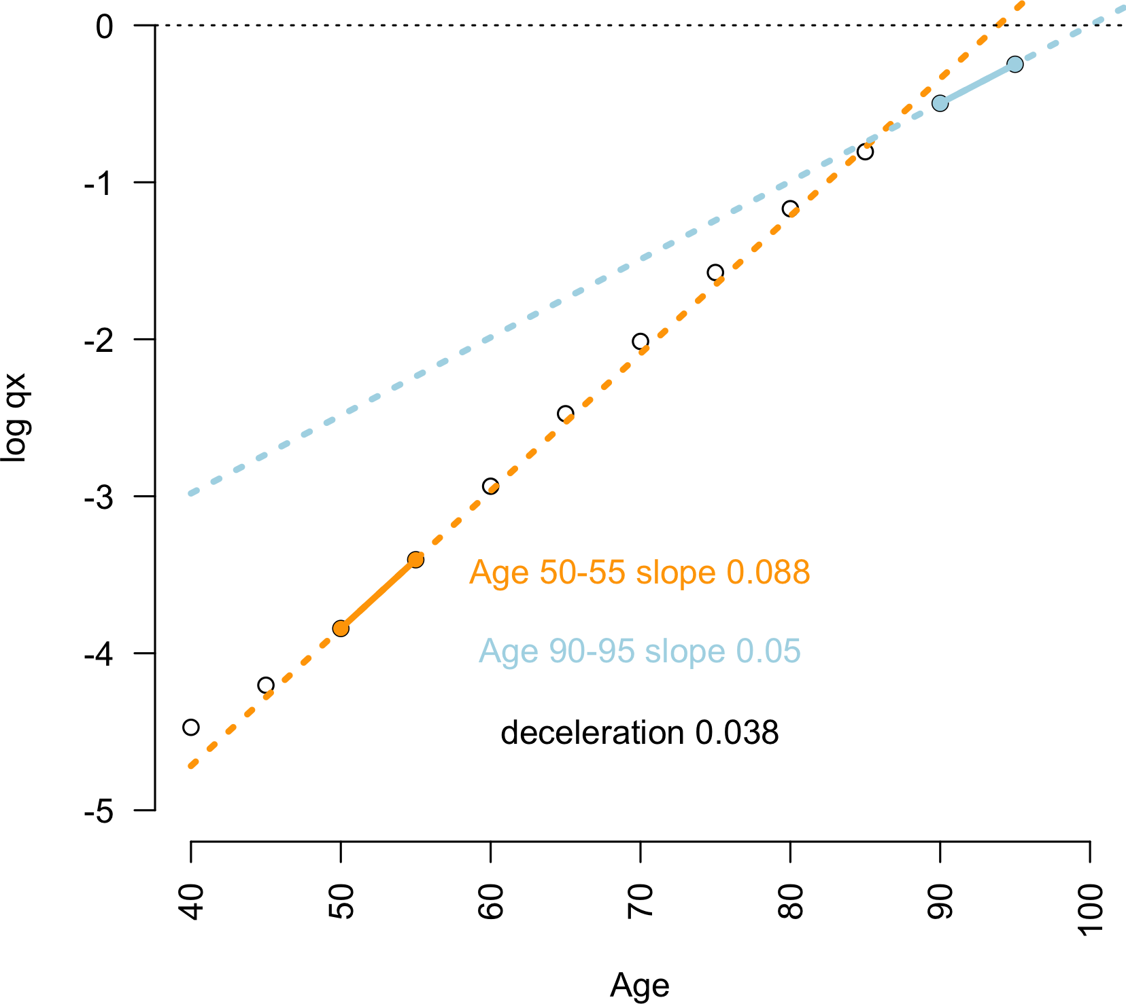
Errors predict this ‘slowdown in ageing’? This departure from linearity?
Size of difference in slope =
bigger deceleration
Flat blue line = late-life mortality plateau
SJ Newman (2018) PLOS Biology. Errors as a primary cause of late-life mortality deceleration and plateaus.

Slide 17
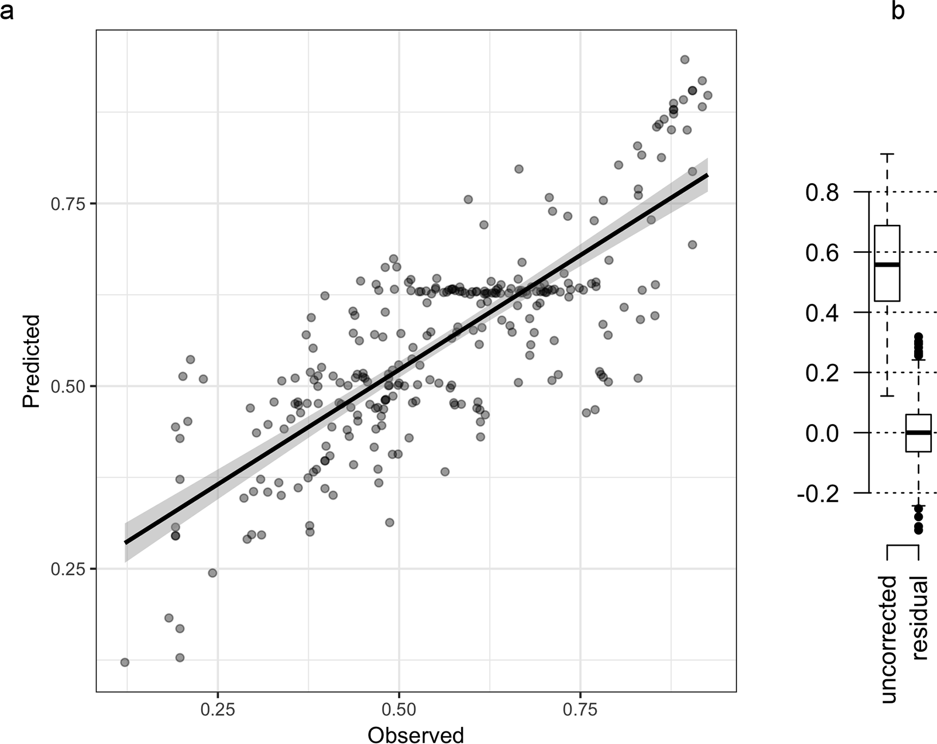
Yes. Quite well.
R=0.8, corrected R²=0.57
Size of deceleration is
predicted by:
% missing birth+death certs,
Continent,
Infant mortality rates.
SJ Newman (2018) PLOS Biology. Errors as a primary cause of late-life mortality deceleration and plateaus.

Slide 18
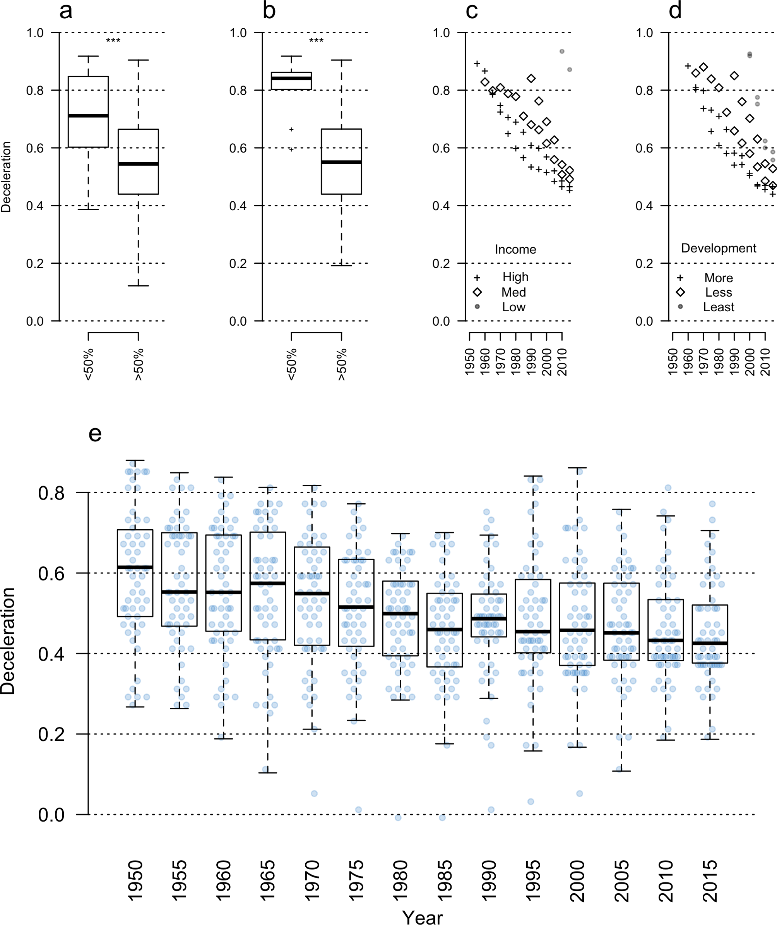
Patterns strongly indicative of errors, not biology.
Mortality plateau size declines by 25% within last 60 years.
If this is a biological effect, why is it regressing toward zero as we gather better data?
*continuously observed UN pops
SJ Newman (2018) PLOS Biology. Errors as a primary cause of late-life mortality deceleration and plateaus.

Slide 19
Patterns strongly indicative of errors, not biology.
Pct registered deaths
Pct registered births
SJ Newman (2018) PLOS Biology. Errors as a primary cause of late-life mortality deceleration and plateaus.

Slide 20






If plateaus aren’t real, neither are the people out here
MSA
(upper limit of life)
MSA
(upper limit of life)
?
The “Jeanne Calment”
zone.
Log probability of death q
Depends on accurate
data in old age
Age
SJ Newman (2018) PLOS Biology. Errors as a primary cause of late-life mortality deceleration and plateaus.

Slide 21
We have no way to check age
“Consider a room containing 100 real Italian centenarians, each holding complete and validated documents of their age.
One random centenarian is then exchanged for a younger sibling, who is handed their real and validated birth documents.
How could an independent observer discriminate this type I substitution from the 99 other real cases, using only documents as evidence?”
SJ Newman 2019 Supercentenarians and the oldest-old are concentrated into regions with no birth certificates and short lifespans bioRxiv, 704080

Slide 22
Is that possible? Do 105+ year olds even exist?
Let’s explore the heresy

Slide 23
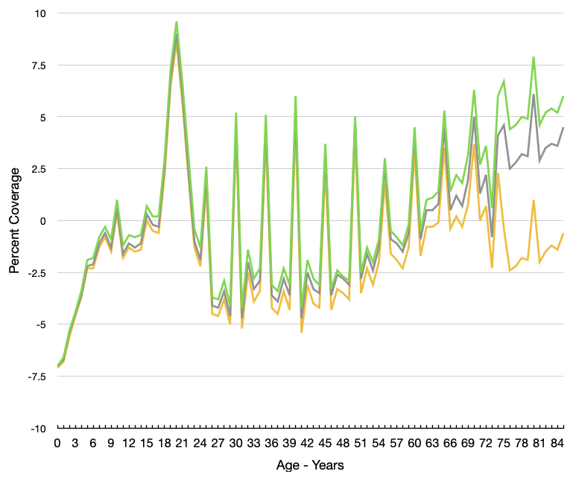

Errors are common
This is 2020 data from USA→
5-9% error rates minimum
Super/centenarian data are
older + lower quality
Age heaping in 2020 US census - https://www.census.gov
Release Number CB22-CN.02

Slide 24
‘Blue Zone’ Demographers (Willcox* et al.) in 2008:
Japan HLW Ministry Data “Amongst the best in the world”
Japanese HLW Ministry in 2010:
92% of all 100+ year olds were checked
82% were dead
(~230,000 corpses with immaculate paperwork)
*Author of Okinawan diet books

Slide 25
One (of six) Greek government pension agencies: caught paying pensions to 1,473 dead 90+ year olds in 2011. The rest were validated…
Greek government in 2011: >9,000 validated 100+ year olds collecting pensions
until …

Slide 26
Greek government in 2012: at least 72% of validated cases
were dead at the time of validation
I am the first to cite that they are dead. In 2018
Greek Census: The ‘Blue Zone’ of Ikaria measured in a larger census area
At most 13 centenarians in the larger region.
The rate of reaching 100 is not even in the top 5 for Greece.

Slide 27
Errors are common in detailed cases
The world’s oldest man had three birthdays (one forged) and no birth certificate
The oldest man in the USA wrote two different ages on his draft card, four different ages in the census, and has no birth certificate
The first person to survive past 110 was part of a group of 421 claimed centenarians
He he was his own son, died age 65, it was on his death certificate for over a century. Nobody noticed.
None of the other 420 centenarians were real either

Slide 28
96% of 105+ year olds died since 1990
overwhelming majority in countries with >95% death cert. coverage
(majority in France, Japan, UK, USA)
General US population: >95-98% have death certificates since 1980s
NHANES I community survey
“Exhaustively validated” supercentenarian and 105+ records-
Died later + more scrutiny = higher coverage, right?

Slide 29
No.
Death certificates for:
8% of all 105+ year olds
< 15% of all 110+ year olds
USA only 7/504 (1.4%) supers have death certificates (70-fold higher error than expected)
Only ~100 “exhaustively validated”. (in 2025 it’s still just 14%)
France? 9386 105+ year olds: not one death certificate reported
A dog ate their homework, I guess.
Newman 2019. https://www.biorxiv.org/content/10.1101/704080v2.full

Slide 30
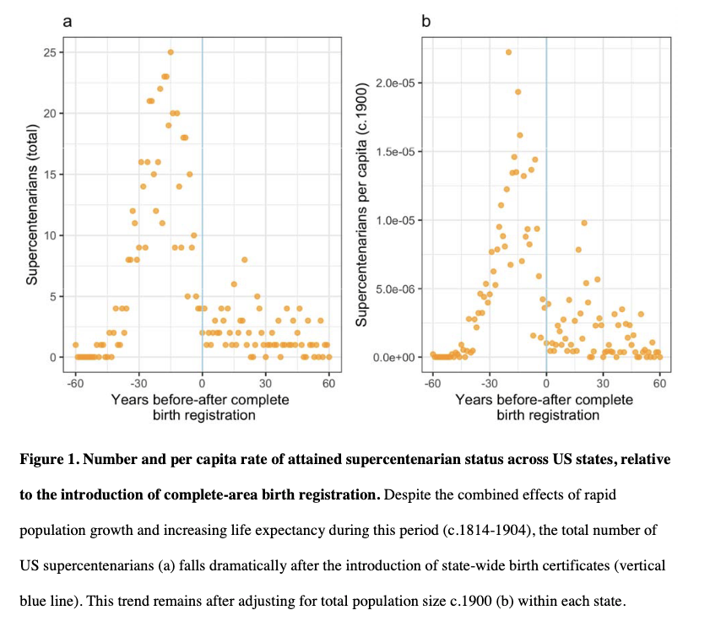
Birth Certificate Allergies, too
“Overall only 6.6% of supercentenarians have an original birth certificate, and 74% of cases have no reported birth documents of any kind: not even parish register data is recorded. None of the 797 [105+ year olds] from the USA is listed as having a birth certificate.”
“241 ‘exhaustively validated’ French supercentenarians in the IDL. Not a single one has a birth certificate.”
(Birth certs are legal and near-universal since 19th C.)
“the IDL explicitly lists the evidence available in support 98% of remarkable-age claimants in the UK (S1 Code). Of the 1116 oldest people in the UK, all but three were born after the introduction of compulsory, nation-wide birth certificates in 1864. However, only eighteen (1.6%) have a birth certificate.”
Newman 2019. https://www.biorxiv.org/content/10.1101/704080v2.full

Slide 31


Circular logic
How do you know your data is not an undetected error?
“We validated our data carefully”
The most carefully validated data in the world
repeatedly turned out to be undetected errors*
*At rates up to 100%

Slide 32
Circular logic
How do you know your data is not an undetected error?
Undetectable errors happen,
but they are rare*
If errors are undetectable, how do you know they are rare?
* Ken Wachter hid behind this one – PLOS Biology 2018

Slide 33
Further concerns
‘Blue Zone’ founder Dan Buettner in 2004:
Loma Linda USA is a Blue Zone “one of the nation's most convincing
cultures of longevity.” (National Geographic)
‘Blue Zone’ founder Dan Buettner in 2025:
Loma Linda USA discovered after editorial pressure
to “find an American Blue Zone” (NY Times)
Buettner “never bothered to delist it” for 20 years (Science)

Slide 34
What was the response of the extreme age scientists?
Correct the data? Explain the patterns?
…
No.
They deleted the counts of people with birth and death certificates from their database.
Then told reporters incorrect numbers.
Newman 2019. https://www.biorxiv.org/content/10.1101/704080v2.full

Slide 35
How deep is the problem?
Take every old-age record from 1950-2021, at all ages.
Reported + cleaned by national demographers → then UN demographers
Analyze where they are, which areas score highest on ‘blue zone’ scale
Newman, S. J. (2024). The global pattern of centenarians highlights deep problems in demography. MedRxiv, 2024.09.06.24313170.

Slide 36
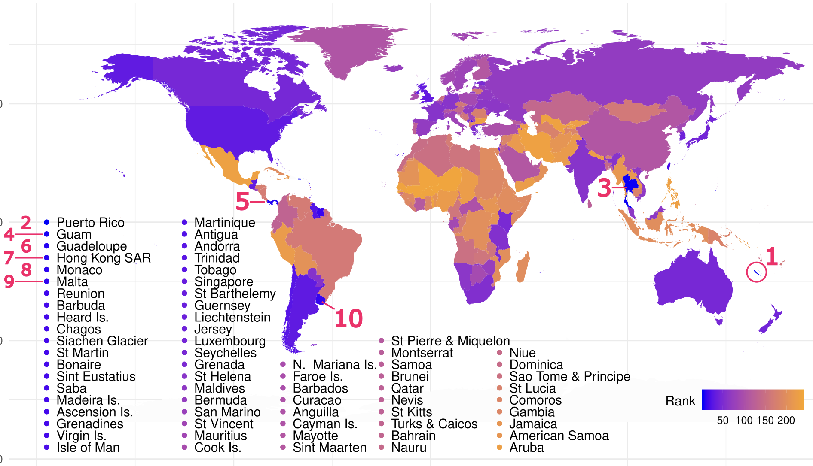
How deep is the problem?
Patterns of UN-estimated life expectancy at age 100. World rankings of life expectancy at age 100, in years, derived from the 2021 UN World Population Prospects data²⁷. Rankings for the ten longest-lived populations at age 100 are numbered.
Newman, S. J. (2024). The global pattern of centenarians highlights deep problems in demography. MedRxiv, 2024.09.06.24313170.

Slide 37
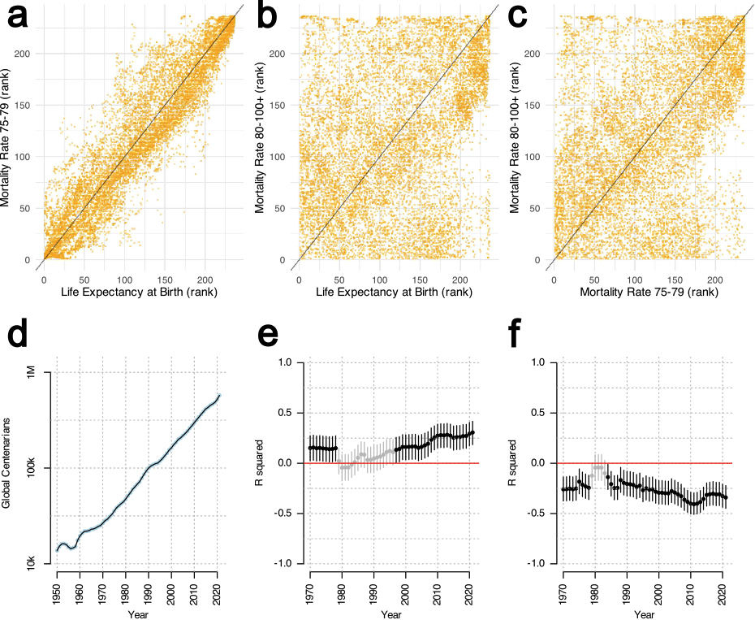
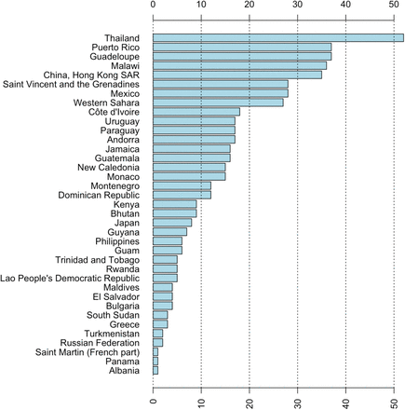
How deep is the problem?
Most likely places to reach 100

Slide 38
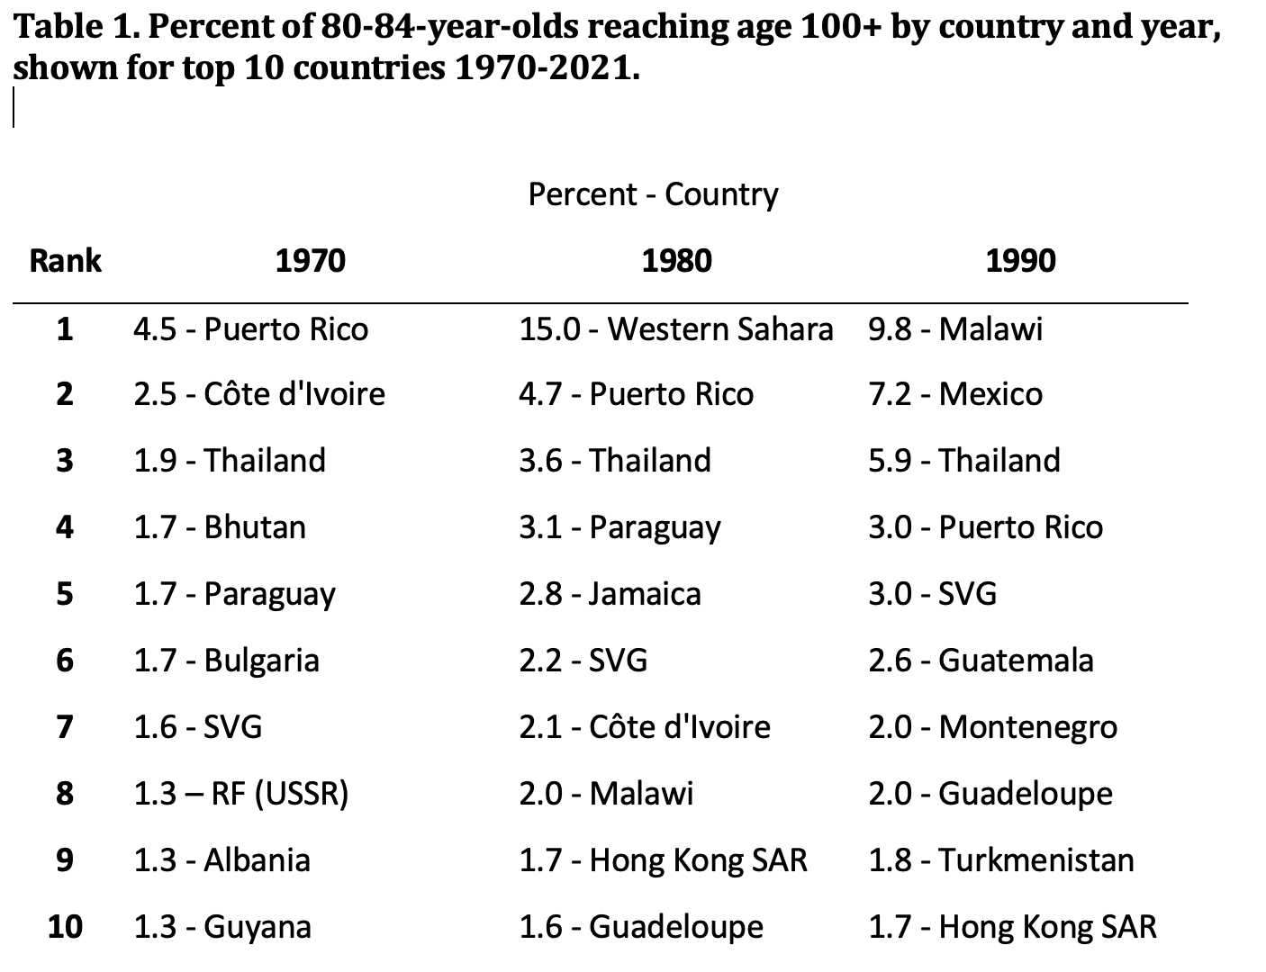
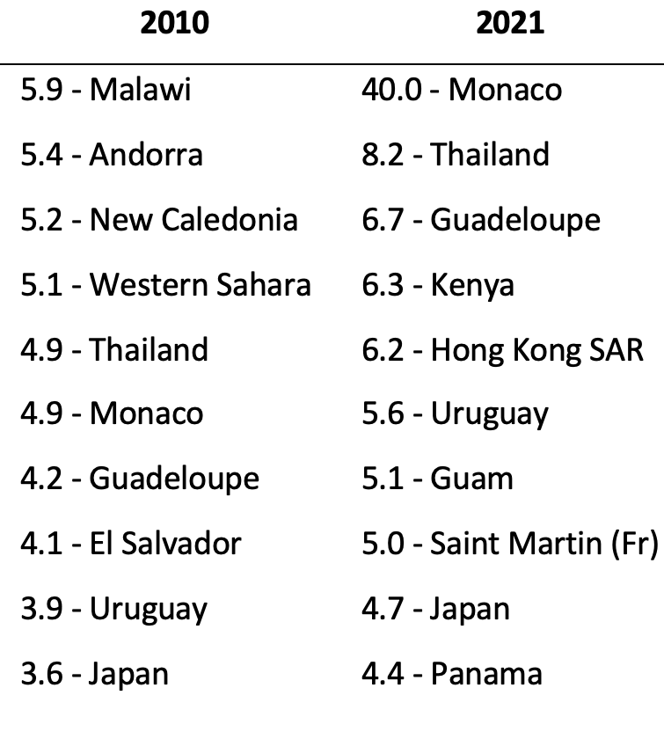
How deep is the problem?
Newman, S. J. (2024). The global pattern of centenarians highlights deep problems in demography. MedRxiv, 2024.09.06.24313170.

Slide 39



Closer to (my) home? UK women – latest ONS estimate
Life Expectancy at age… | Black African | Bangladeshi | Black Other | Pakistani | Other | Asian other | Black Caribbean | Indian | Mixed | White
75-79 | 19.2 | 18.1 | 18.0 | 15.3 | 15.7 | 15.5 | 15.0 | 14.3 | 13.7 | 13.3
80-84 | 15.7 | 15.5 | 14.5 | 12.0 | 12.1 | 11.8 | 11.6 | 11.0 | 10.4 | 9.9
85-89 | 13.3 | 13.5 | 12.2 | 9.4 | 9.4 | 8.9 | 8.9 | 8.4 | 8.0 | 7.2
90+ | 11.7 | 11.0 | 10.6 | 8.1 | 7.5 | 7.2 | 6.8 | 6.6 | 6.0 | 5.3
The poor people with few
birth certificates
The rich privileged people
with many birth certificates
ONS data – 2024 release for life expectancy in UK by ethnicity (with much thanks – absurdity pointed out by KCL)

Slide 40
I was shouted at a lot.
I left demography last January.
And then…

Slide 41



I was ignobled
Moungi Bawendi looking happy
Esther Duflo looking away
Abhijit Bhanerjee looking dubious

Slide 42
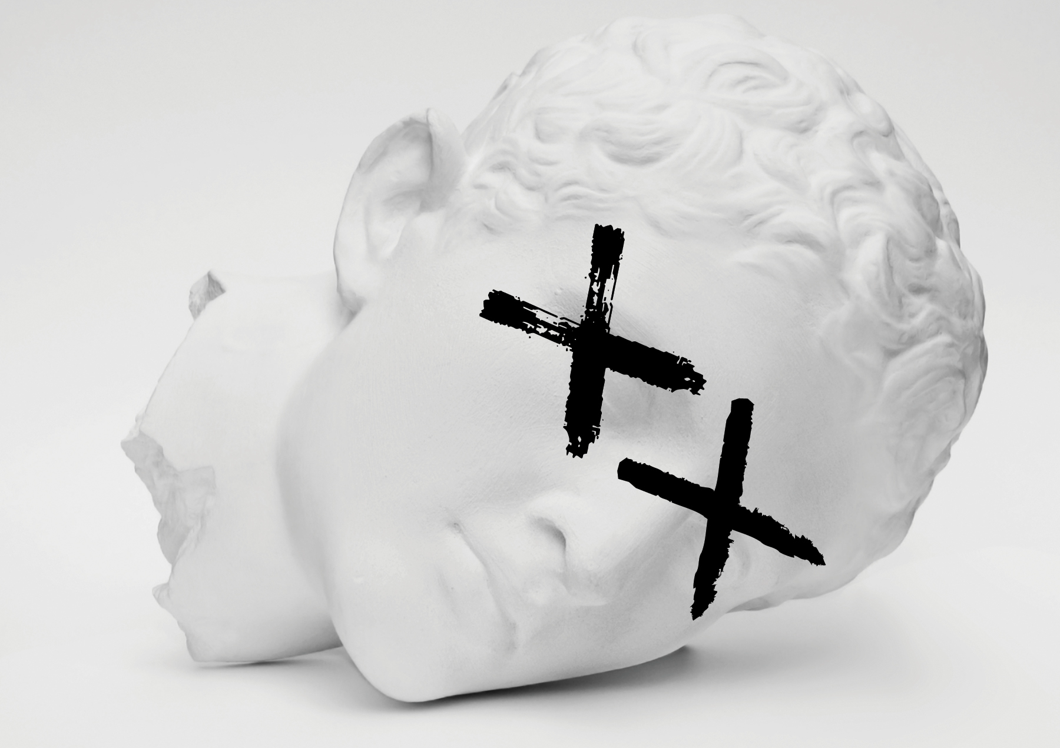
MORBID
An iconoclastic adventure to Debunk Longevity Science
by the Oxford Boffin who won the Ig Nobel Prize
On Sale June 9th 2026
Pre-order now from Penguin Random House, MIT Press, Amazon,
and all good bookshops

Slide 43

Acknowledgements
Huge thanks to:
My PI - Prof Felix Tropf
My lab – Rafael Geurgas, Laura Sheppard, Katie Thompson Five Nobel laureates, Marc Abrahams,
and some person off the street for my Ig Nobel
My only coauthor – Professor Simon Easteal –
and Professor Sarah Harper for giving me refuge
Funding? £0 and counting
Huge thanks to Penguin / MIT press
Any Questions?

Slide 45
Birth Certificate Allergies, too
“Overall only 6.6% of supercentenarians have an original birth certificate, and 74% of cases have no reported birth documents of any kind: not even parish register data is recorded. None of the 797 [105+ year olds] from the USA is listed as having a birth certificate.”
“241 ‘exhaustively validated’ French supercentenarians in the IDL. Not a single one has a birth certificate.”
(Birth certs are legal and near-universal since 19th C.)
“the IDL explicitly lists the evidence available in support 98% of remarkable-age claimants in the UK (S1 Code). Of the 1116 oldest people in the UK, all but three were born after the introduction of compulsory, nation-wide birth certificates in 1864. However, only eighteen (1.6%) have a birth certificate.”
Newman 2019. https://www.biorxiv.org/content/10.1101/704080v2.full

Slide 46
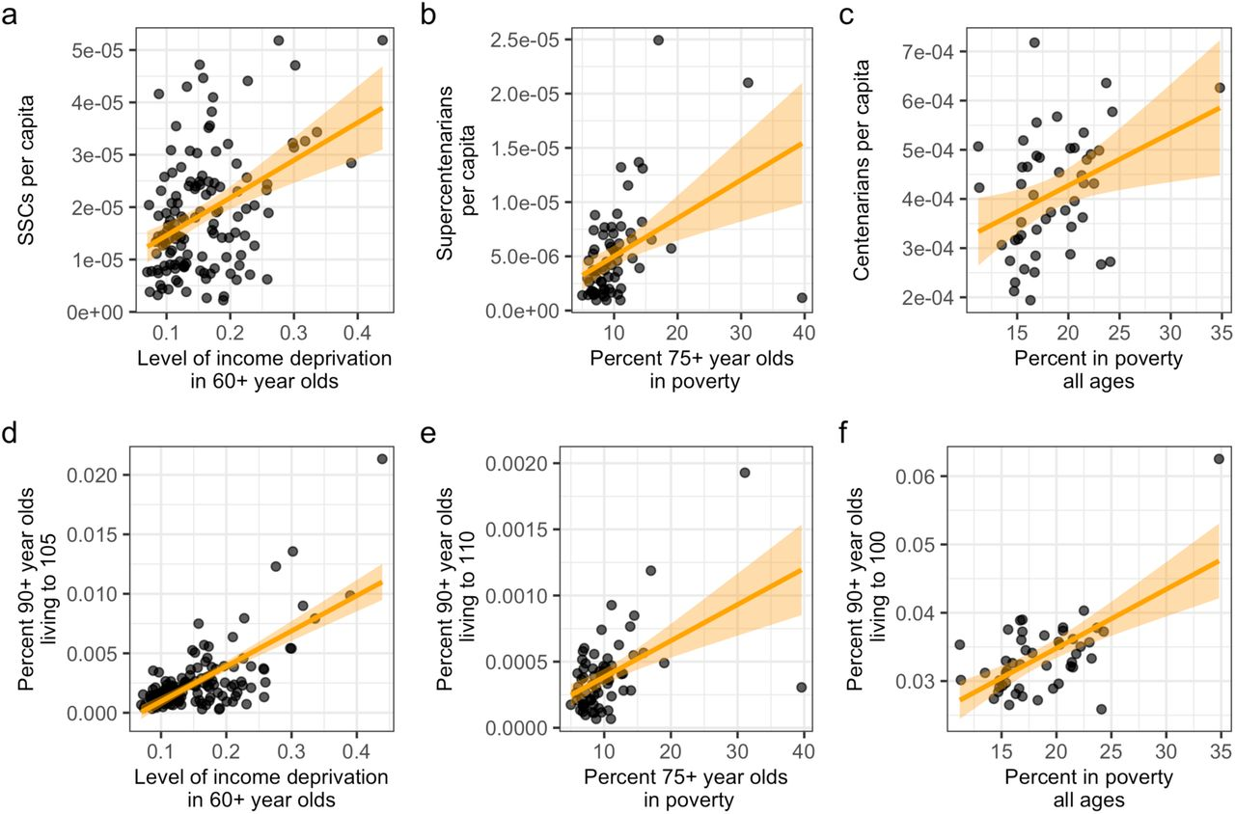
UK France Japan
‘Poverty and old-age poverty are positively correlated with the density of SSCs per capita in the United Kingdom (a; r = 0.42; p < 0.000001; 127 regions), supercentenarians in France (b; r = 0.42; p = 0.0004; 66 departments; r = 0.58 in the 63 mainland departments), and centenarians in Japan (c; r = 0.36; p = 0.01; 47 prefectures). These relationships strengthen if density is instead measured by the fraction of 90+ year old people who exceed age 105 (d, UK; r = 0.71, p < 2e-16), age 110 (e, France; r = 0.51; p = 0.00001), or age 100 (f, Japan; r = 0.62, p = 0.000004).’
Newman 2019. https://www.biorxiv.org/content/10.1101/704080v2.full

Slide 47
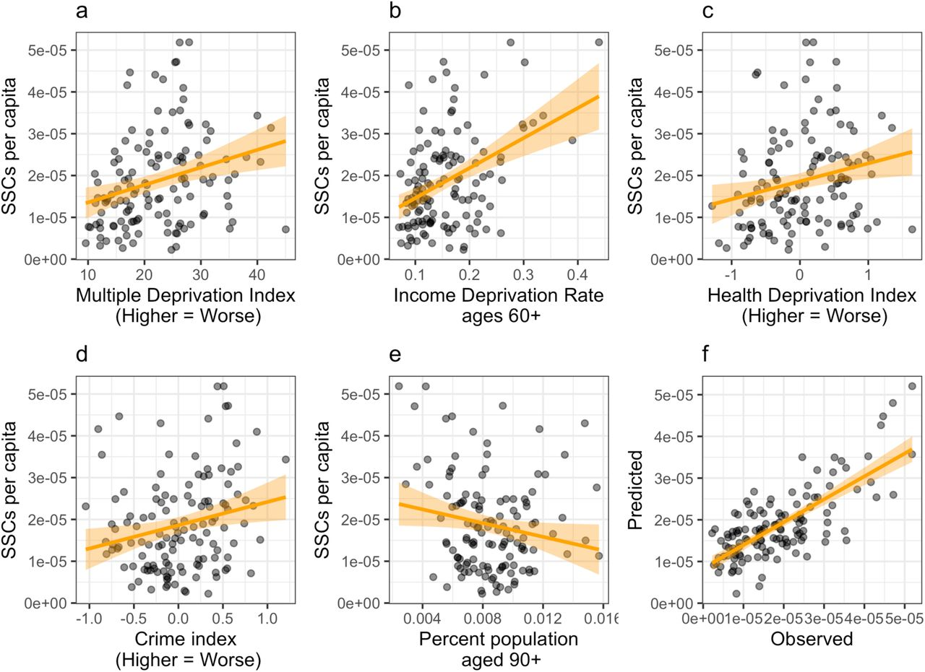
UK
Newman 2019. https://www.biorxiv.org/content/10.1101/704080v2.full

Slide 48
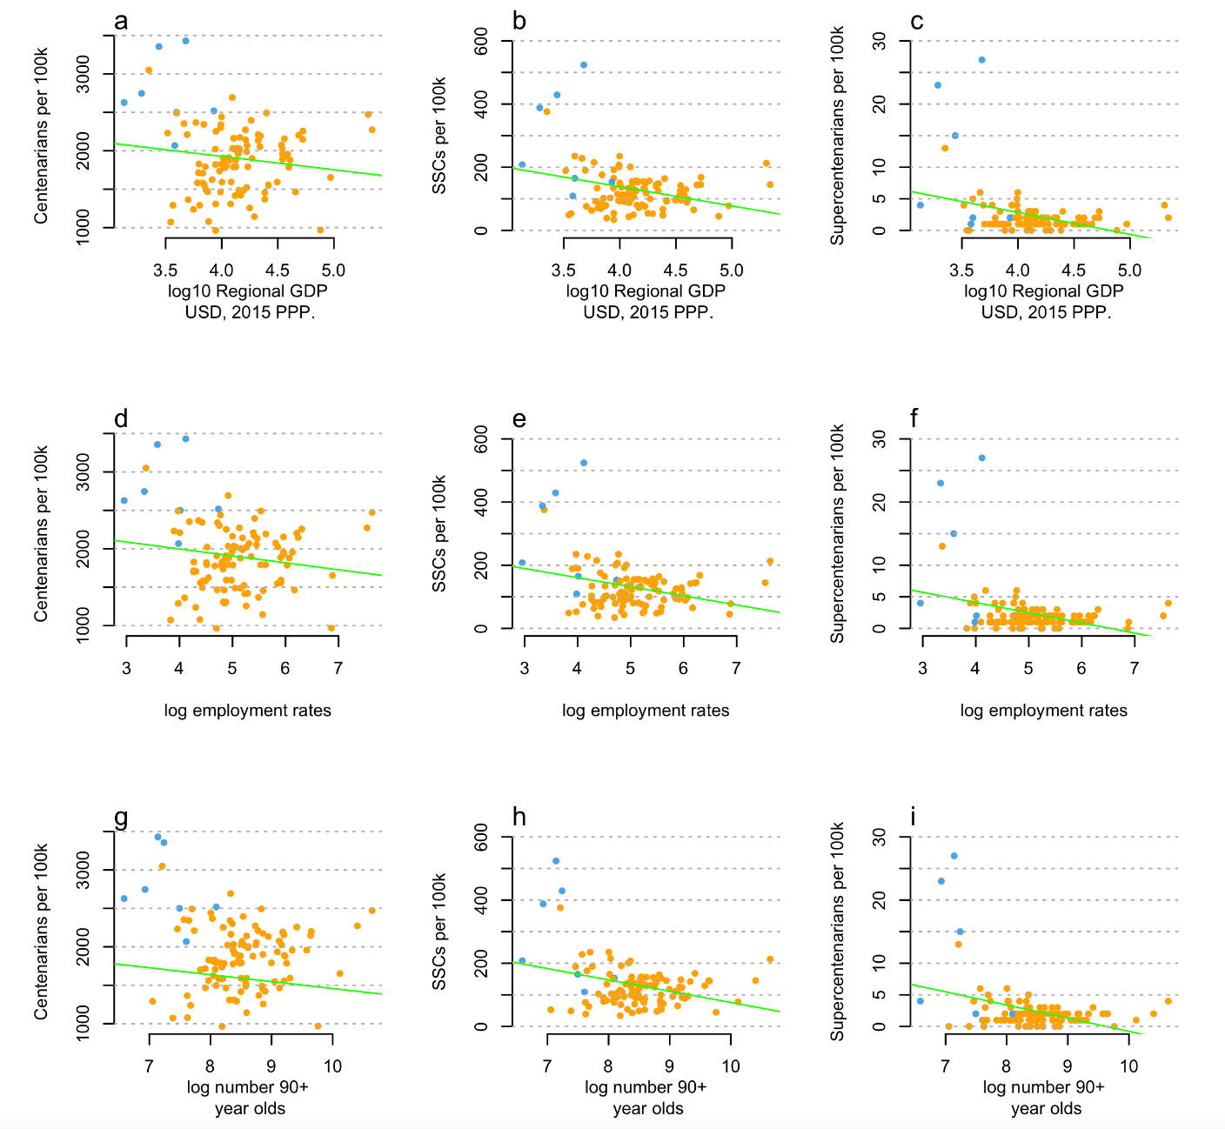
Italian figures
SJ Newman (2020) BIORXIV. Supercentenarian and remarkable age records exhibit patterns indicative of clerical errors and pension fraud

Slide 49
SJ Newman (2020) BIORXIV. Supercentenarian and remarkable age records exhibit patterns indicative of clerical errors and pension fraud

Slide 50
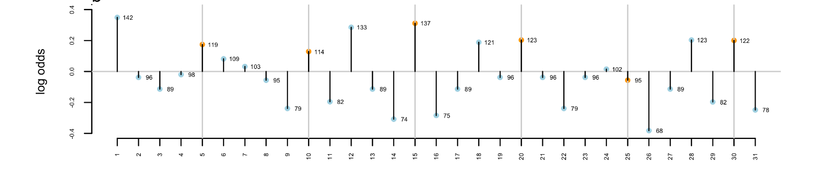
They have wobbly birthdays
(born on the 1st, 5th etc. far more often than expected)
Day of the month

Slide 51
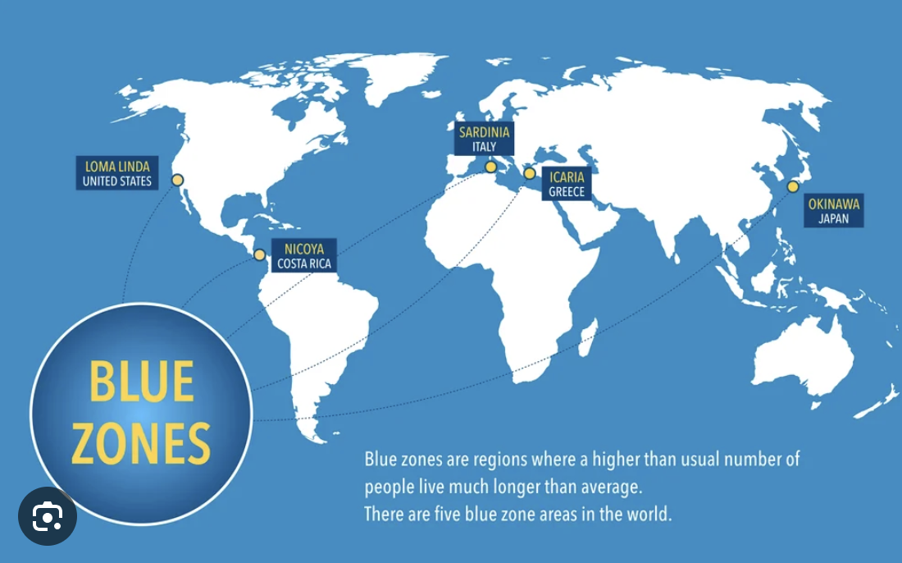
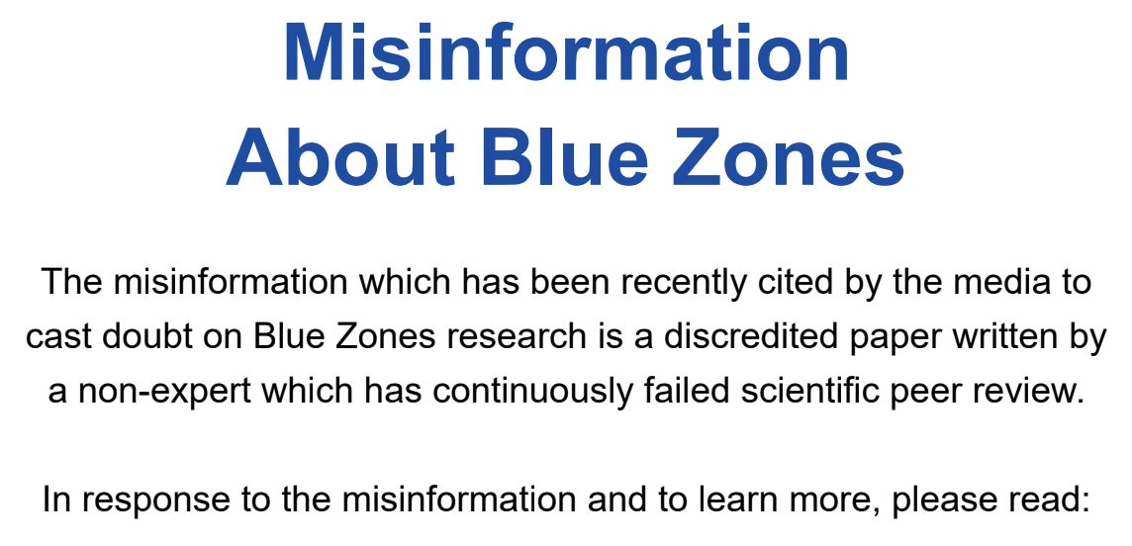
Further concerns
Loma Linda discovered via
Editorial pressure to “find an American Blue Zone” (NY Times)
And “never bothered to delist it” (Science)
Singapore discovered after
pressuring scientists to find BZ
In region with “marketable cuisines” (Substack)
Now owned by Dr Oz –
3x winner of the Pigasus award for misinformation in science

Slide 52
“Why is it not published”
The better question:
“If the preprint is so widely read, why are there no answers?”
After 5+ years – toxic responses, gatekeeping, abuse, hatemail, silence, but no answers.
(The Economist, WaPo and NYT reproduced + confirmed the analysis in 5-14 days)
The bullying works. I left demography last January.

Slide 53
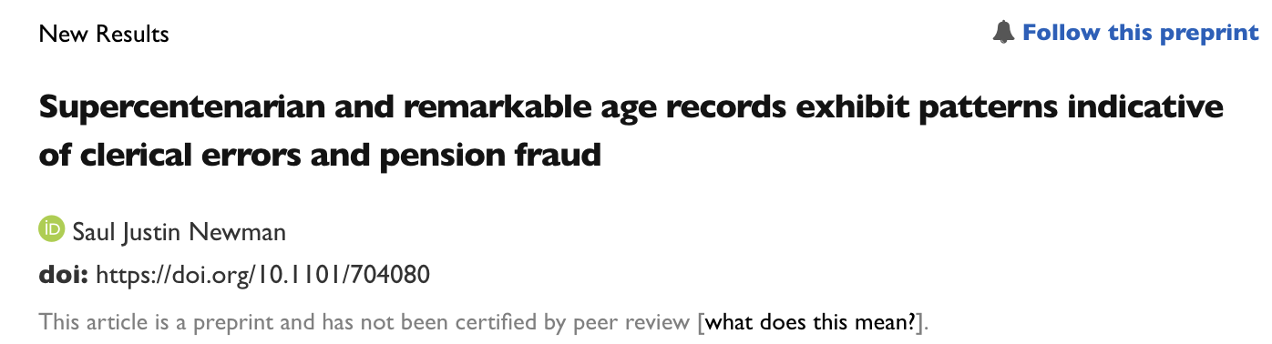
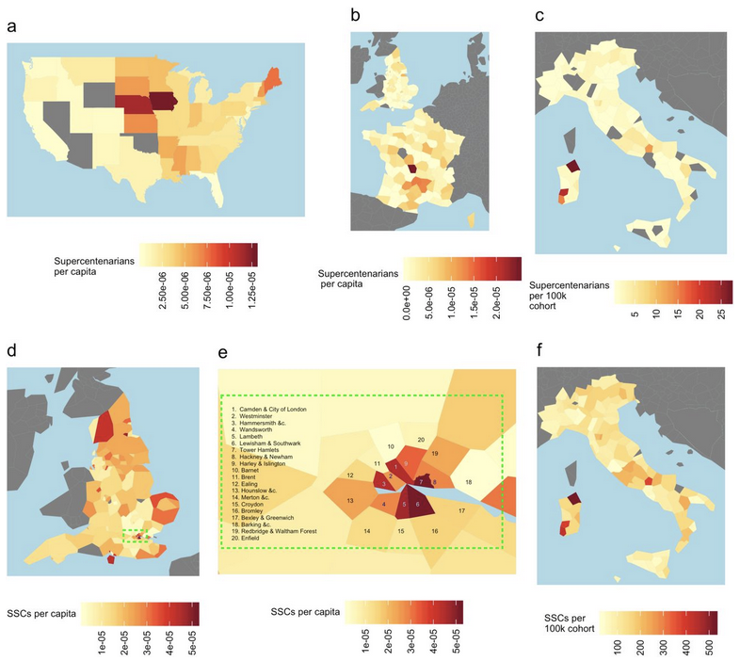
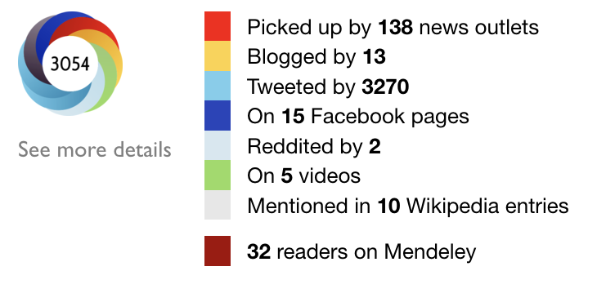
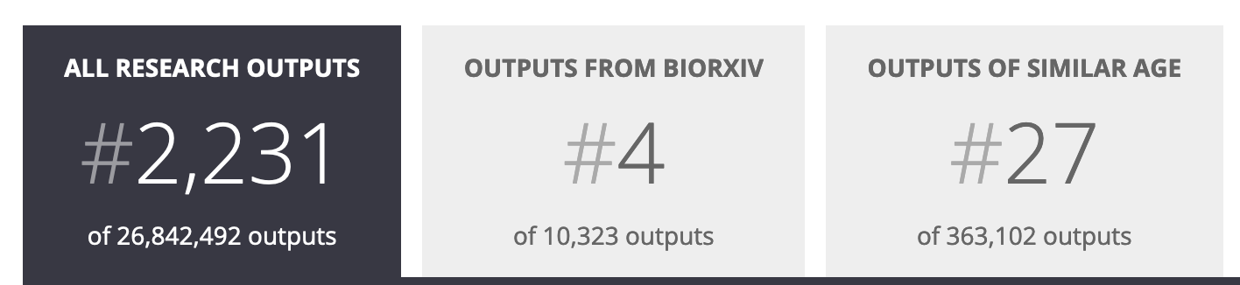
The Ig Nobel paper
Newman 2019. https://www.biorxiv.org/content/10.1101/704080v2.full

Slide 54
Why do we care?
‘Limit-possible’ solution:
MSA
(upper limit of life)
‘Flattening’ solution:
q = 1
?
About q = 0.5
q limit
(upper limit of mortality risk)
Log probability of death q
Depends on accurate
data in old age
Age

Slide 55
Old-age data is our model of the future
UN projections rely on it.
Pension rates, insurance, healthcare planning too.
Even World bank projections.
How deep is the problem, and
if old-age data is untrustworthy,
when does it ‘go bad’?

Slide 56
We can simulate – but we don’t know the pattern of the errors
Or the underlying null
Age limit 105
Null model log-linear
10% error
1% error
0.1% error
0.01% error
Theoretical paper
In preparation,
finished
About Dec. 2024

Slide 57
So it’s all corrupted. What now?

Slide 58
Q: How does this happen in a healthy research ecosystem for seventy years?
It doesn’t.
So I wrote about why.

Slide 59
Coming up in Penguin / MIT press:
Projections and even current ‘clean’ data are shocking
Racism, fraud, misconduct, bullying, incompetence,
and money distort the field
Huge cultural problems in aging research
Morbid - An iconoclastic adventure to debunk the science of dying

Slide 60
A few teasers:
World’s oldest man is a fake. Six times in a row.
World’s oldest woman lives in an insane asylum for 70 years (maybe?)
Her identity was invented by an institution murdering and beating patients.
300,000+ dead 100-year-olds
Multiple deaths linked to leading academic institutes,
child grooming by leading researchers
Faked world records – by the researchers
Pedophilia attempts, covered up, and ultimately unpunished – by major
aging researchers.

Slide 61
A few teasers:
A major long-running study on heart aging uses 100% invented ages.
Literally just made up.
EUROSTAT predicts the best place in EU to live to 100 is…
North Africa and Rural Poland
The National Institutes of Aging runs a 20-year program on anti-aging
interventions. It makes a statistical mistake. Trials don’t measure aging.
Children’s blood obtained under dubious pretenses, in an attempt to get
Peter Theil to invest injected by a disgraced doctor from MIT
supervised by Stanford academic excluded from medical practice = a dead patient (~2L of child-blood in one injection)

Slide 62
A few teasers:
Harvard Professor David Sinclair decides Resveratrol (wine sediment) is
a ‘miracle molecule’ that ‘halts aging’. Sells for $720 million USD to GSK.
It’s not absorbed into the body.
130+ clinical trials. It causes diarrhea.
GSK gives it to cancer patients: they dehydrate and die of kidney failure.
Sinclair opens a fertility clinic to ‘reverse reproductive aging’ –
“intentionally offering its products in countries where clinical trials are not required” to avoid regulation. $1.8 Billion USD in losses.
Treatment banned by FDA.

Slide 63
A few teasers:
Sinclair rinses and repeats. Loses ~$8bn.
Thrown off NASDAQ for operating non-compliant “shell company”
with Nir Barzilai.
Lost 99.7% of investor funds.
Now sells dog supplements outta Harvard. clinical trial measured dog intelligence, largely fails anyway
(Funding by Chrissy Teigan and Pedro Pascal)
Eight Nobel Laureates still on the board of his companies..
He’s the lead editor of ‘Aging’ – most important journal in the field.

Slide 64
A few teasers (the personal ones):
I am publicly invited to excavate a famous corpse
I get accused of being a Russian spy in the Washington Post – emails arrive!
‘Big dog food’ conspiracy theories
I get an open letter to me, the Queen, the Pope, and Vladimir Putin.
(It makes the papers)
The ‘world’s oldest dog’ is uncovered as a fraud, and I’m suspicious of the cat

Slide 65
Unanswered –
Why is Okinawan survival past age 100 predicted (R²=0.7) by bombing of birth certificates?
Why do Japanese centenarians have the highest rate of smoking and drinking of any age group? Even higher than prison pops?
Why do <20% of supercentenarians have birth records, but over 90% of the rest of the population?
Why does the new England centenarian study have <30% rates of birth certificates, but New England c. 1900 have near-complete coverage? Why does the oldest man in the world have three birthdays, two wedding dates to the same wife, an undocumented double name change, multiple conscriptions to the same army within <12 months, etc etc etc……

Slide 66
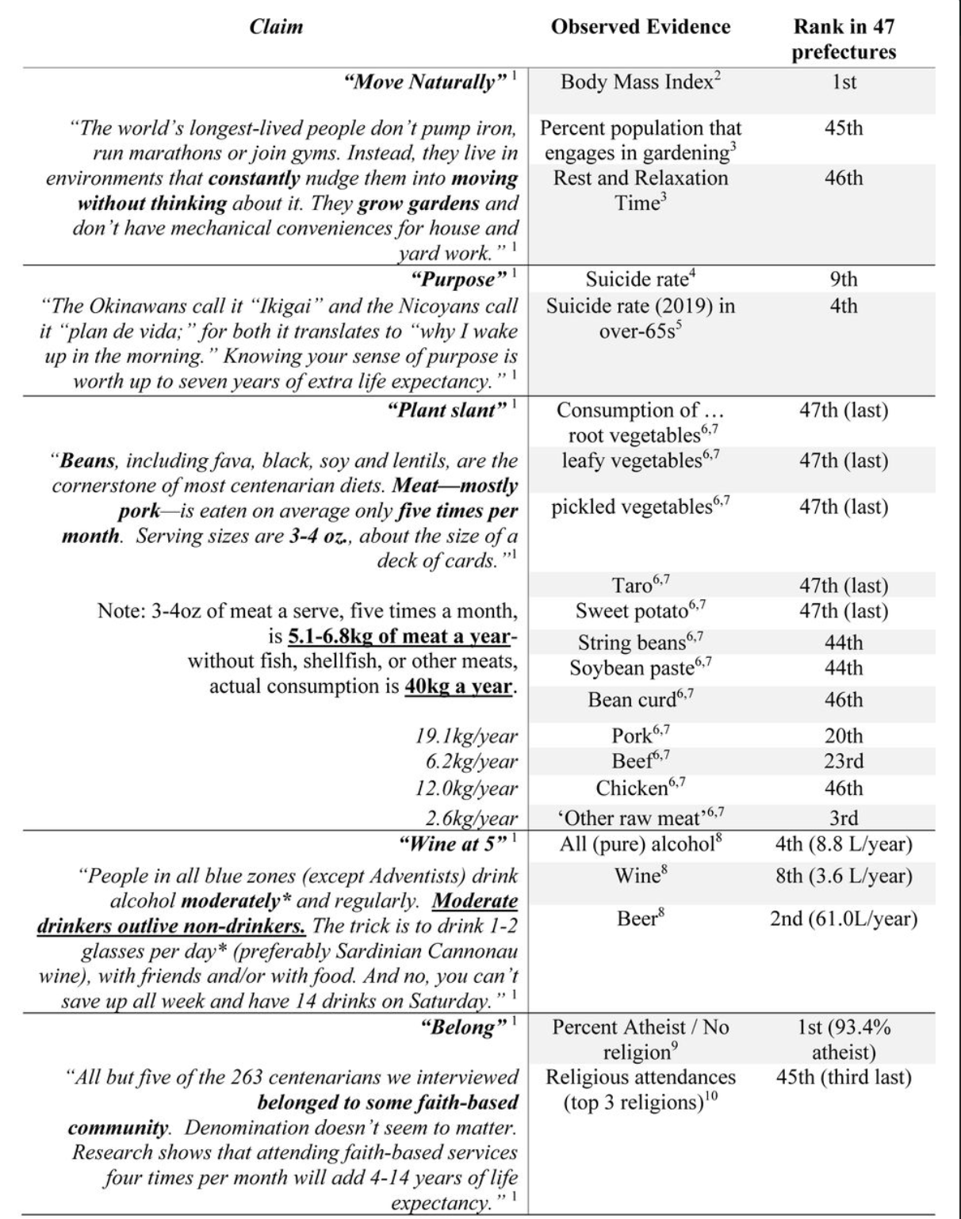
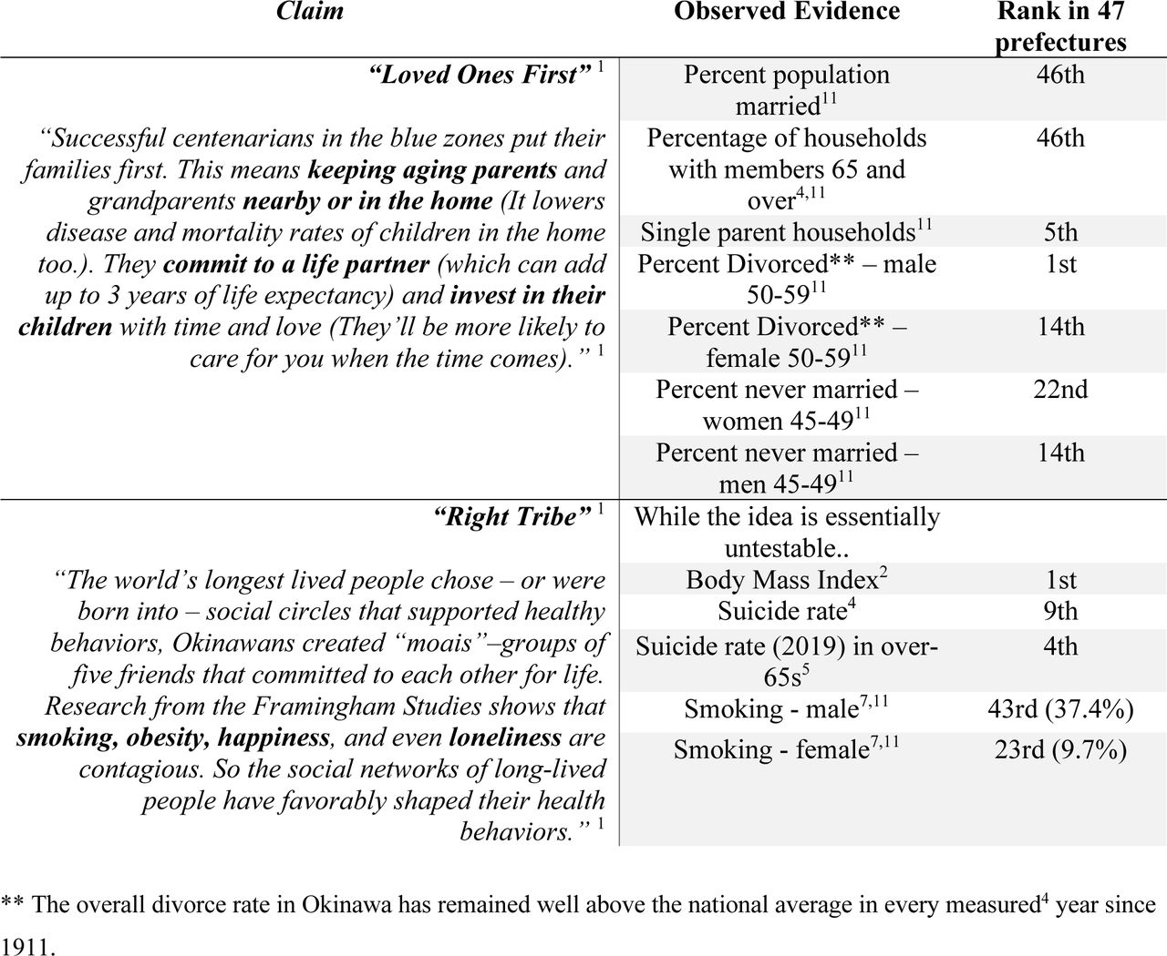

Slide 67
Knowing a person’s age is fundamental to demography
“Consider a room containing 100 real Italian centenarians, each holding complete and validated documents of their age.
One random centenarian is then exchanged for a younger sibling, who is handed their real and validated birth documents.
How could an independent observer discriminate this type I substitution from the 99 other real cases, using only documents as evidence?”
SJ Newman 2019 Supercentenarians and the oldest-old are concentrated into regions with no birth certificates and short lifespans bioRxiv, 704080

Slide 68
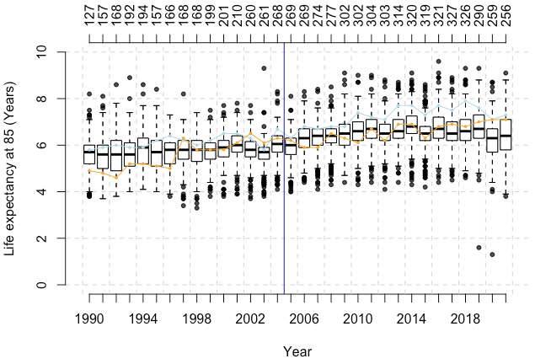
Figure 1. The unremarkable old-age life expectancy of European blue zones. Life expectancy at age 85+ across the European Union, measured by EUROSTAT every year since 1990 (boxplots). Both Sardinia (light blue) and the region of Ikaria (orange) demonstrate unremarkable late-life survival relative to all other regions of the European Union for extended periods both before and after the discovery of ‘blue zones’ (vertical dark blue line). Actual outliers for high or low old-age life expectancy are shown as black points, the number of regions measured is shown as labels on the secondary axis (top x-axis) and the year on the bottom x-axis. At no point has either ‘blue zone’ achieved remarkable or outlier status in old-age survival rate.
This is EUROSTAT data – data from the EU government, collected from European governments in general. In 1990, Sardinia was equal 51st in Europe for old-age survival (of 128 regions). The region containing Ikaria was 109th. These numbers have not really improved.

Slide 69
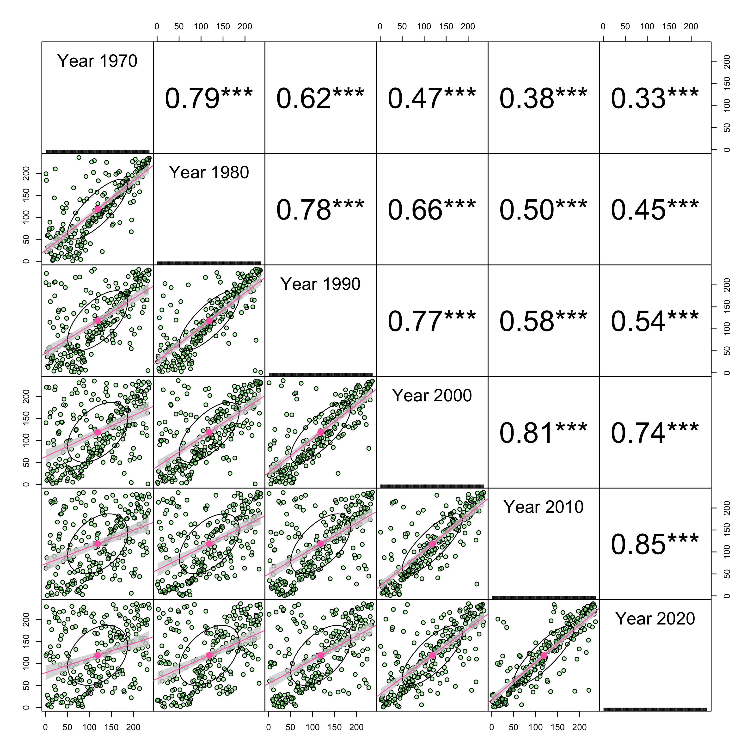
Figure 3. Rank concordance across non-overlapping cohorts of the oldest old. The ranks for centenarian attainment – survival rates from age 80 to ages 100+ – remain consistent across sizeable gaps and degrade slowly over time, despite the complete replacement of cohorts.

Slide 70
Further concerns
Markides and Machalek “While errors in the data are recognized as a possible explanatory factor, a consensus seems to have developed that the [old-age mortality] crossover is indeed real and results from higher early mortality that removes less hardy blacks”²³
[Prof Jaques] Vallin¹⁴ claimed that extreme age records on Guadeloupe and Martinique are a positive outcome of the African slave trade’s “selection of the strongest individuals” through “the tremendous health selection effect of slavery”, and that such hypothetical effects are further enriched "due to low immigration and high fertility among black people compared to white”¹⁴.

Slide 71
[Robert Young claims]
that African-Americans have “thicker skin than Caucasian-Americans” which “protects their internal organs” because “‘Black don’t crack’”²⁴.
“greater selection pressures, and thus faster evolution” in African-Americans because of the “pruning” benefits of slavery (as with Vallin) and the forced breeding of slaves²⁴ because “often the most-healthy African American males were selected to be the ‘stud’ that would then be mated with the healthy females; less-healthy slaves would be discouraged from breeding”²⁴.
Young extends his racist theory to explain why the USA has supercentenarians and Africa does not. He first states that racial ‘pruning’ must be moderate to be effective, as “clearly, the Jewish population in Auschwitz had a very short life expectancy (akin to cutting a tree down, not pruning it)”²⁴. He then uses this argument as an explanation for the lack of African-resident supercentenarians²⁴ by equating living standards in modern Africa to being Jewish in Auschwitz.

